Slide 1
CSC1004 Tutorial 6 Ruixing Jin

Slide 2
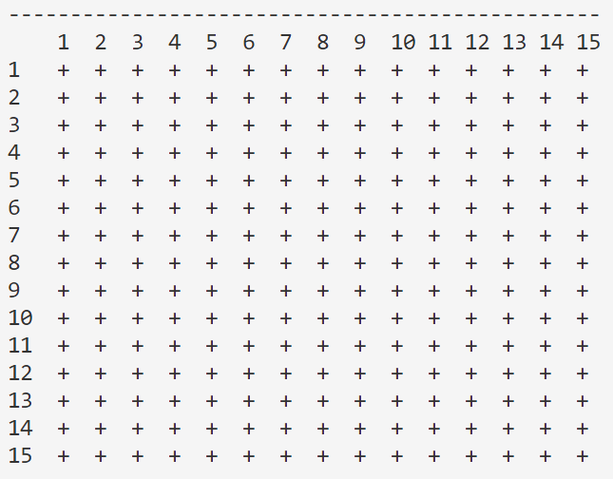
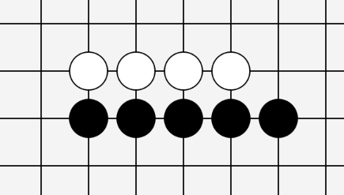
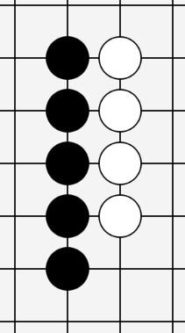
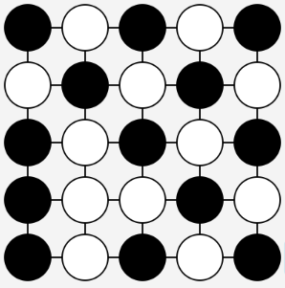
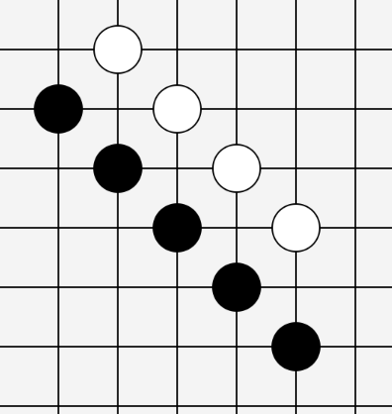
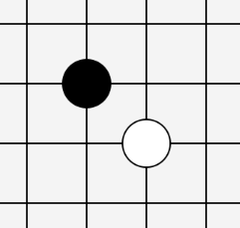
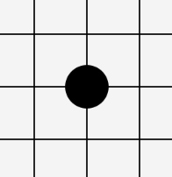
Gomoku Game (Recall)
Game Over
15×15 Chess Board
One Player Wins (Black in This Example)
A Draw (No One Wins)
(e.g. we
suppose
the board
is scaled
down
to be
5×5)
Horizontally
All positions for stones (chess)
are taken without reaching
the winning condition.
Black Plays First
Player 1, place first
No Overlap
vertically
Already Placed
It’s not allowed
to place a stone
on some existing
stone.
(Also, it’s not allowed
to place any stone
If the game is over)
Player 2,
place later
Five stones in a line
Gomo
(and the stones should be placed on the intersection of the lines of the board)
diagonally
五目

Slide 3
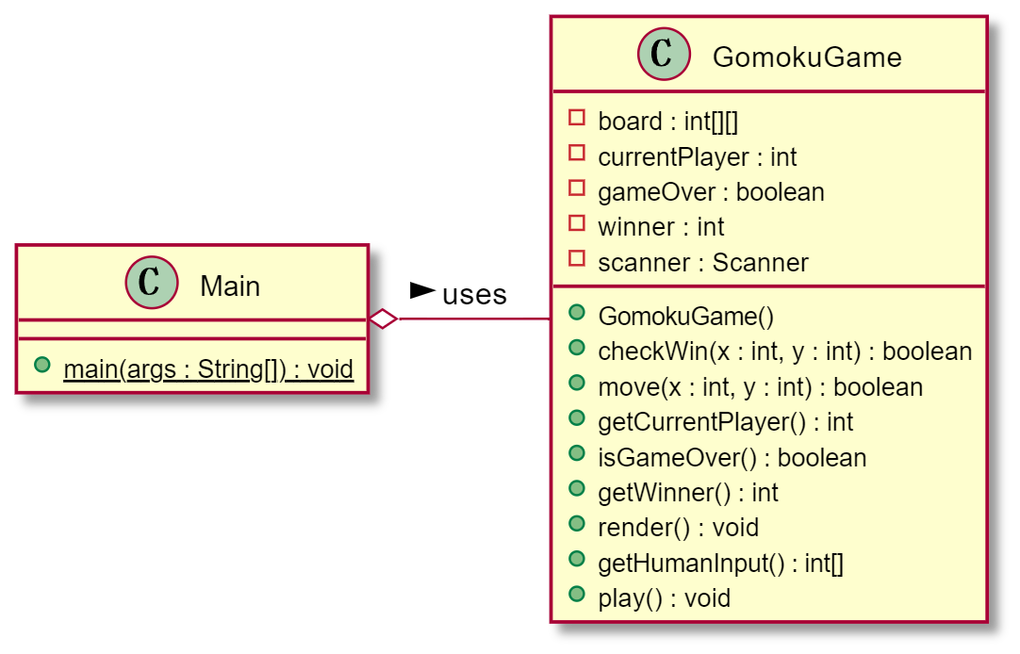
Class Design & Control Flow (Recall)
Class GomokuGame
The main() function of Main class holds one instance
Constructor()
Call the play() function to start the loop
The While loop in the play() function
gameOver?
Yes
No
render()
x,y = hunmanInput()
> Show the result
> Close input flow
move(x,y)
Use checkWin() to modify gameOver

Slide 4
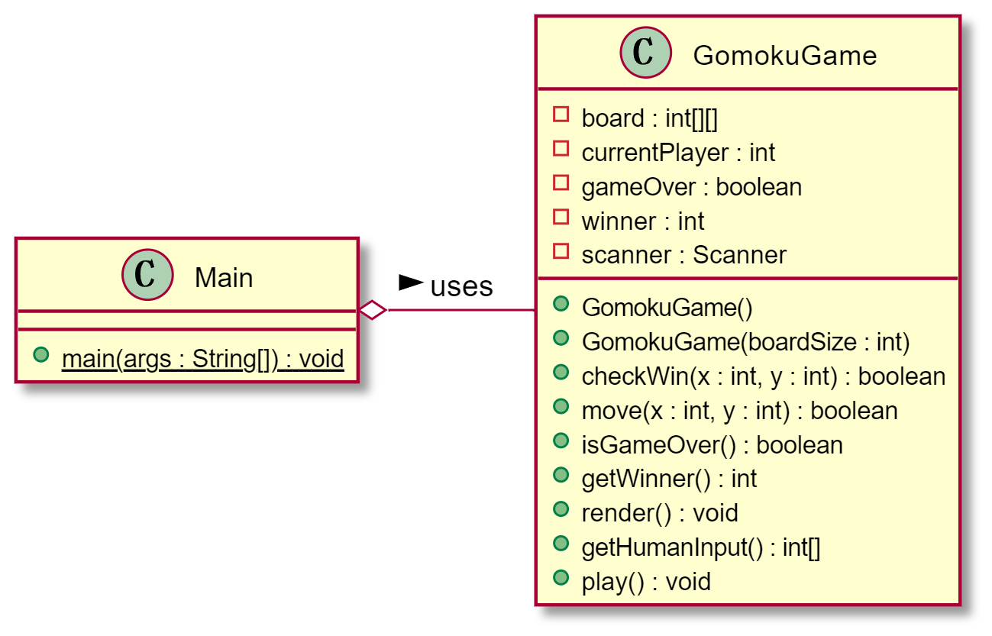
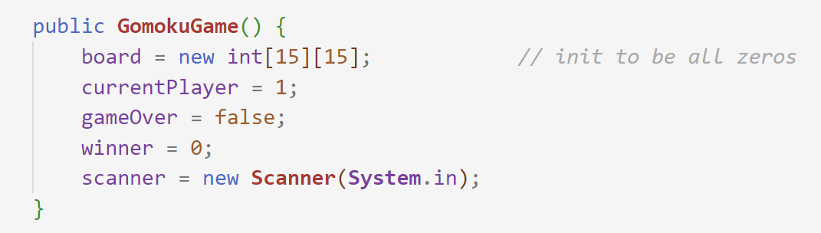
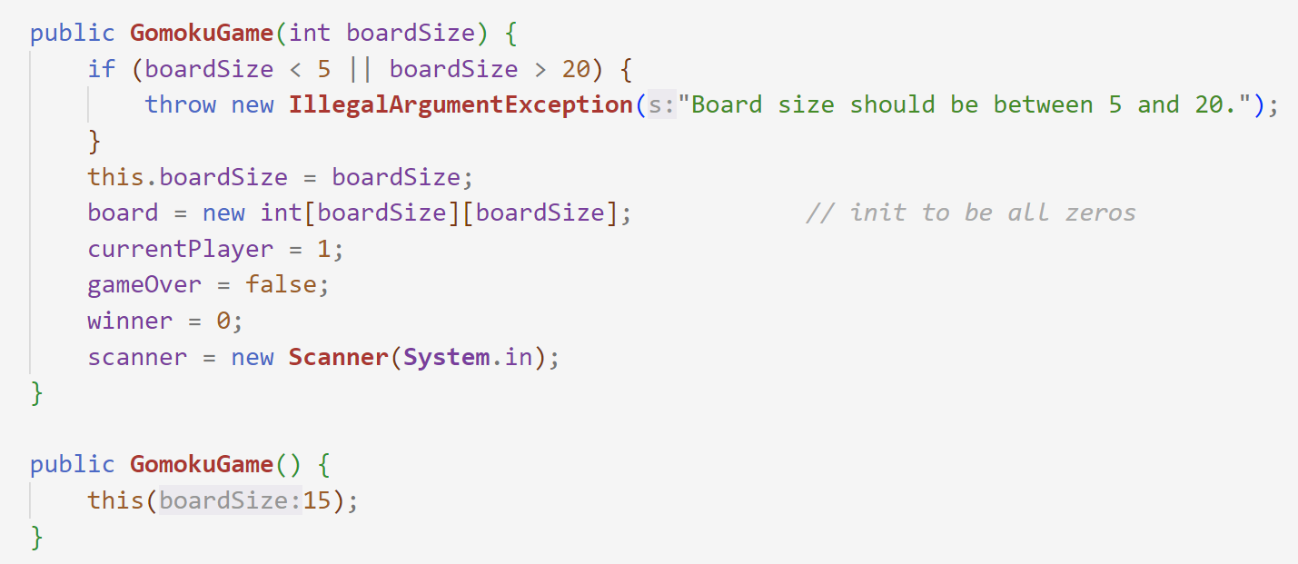
Class Design & Control Flow (Recall)
Initialize the chess board
Initialize other variables like currentPlayer, gameOver, winner
Initialize the input scanner (optional)
GomokuGame()
i.e. the constructor
One may use another classname “GomokuEnv” for
the meaning of some “environment”.
added

Slide 5
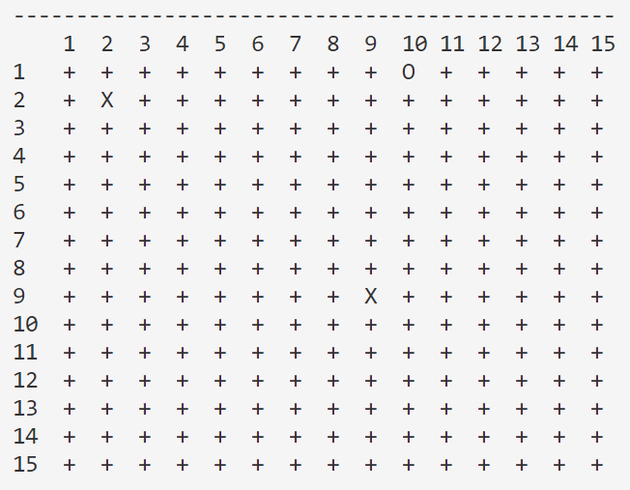

${\text{(}\text{Iteration} \text{1}\text{)}}^{+}:$ Implement & Improve
Better show the row and column number as numerical input is used
Denote “+” for some unused position, “X” for the black stone, and “O” for the white stone
Loop over the rows and columns to print all those required things
Alignment should be considered
render()
(A Quick Review Here)
Note: actually the whole render() function is optional as we’d use JavaFX for rendering in the future, but we need such function for the whole
program to be “complete” so that we can make some tests and ensure that our core components work properly, to avoid messing up with
those future GUI codes.
boardSize
It’s a good training for rendering calculation, helpful for the GUI case
-
-
-
-
-
-
-
-
-
…
-
-
-
-
-
-
-
-
-
…
1
2
…
9
1
0
1
1
…
1
+
+
+
O
+
2
+
X
+
+
+
…
boardSize
9
+
+
X
+
+
1
0
+
+
+
+
+
1
1
+
+
+
+
+
…

Slide 6
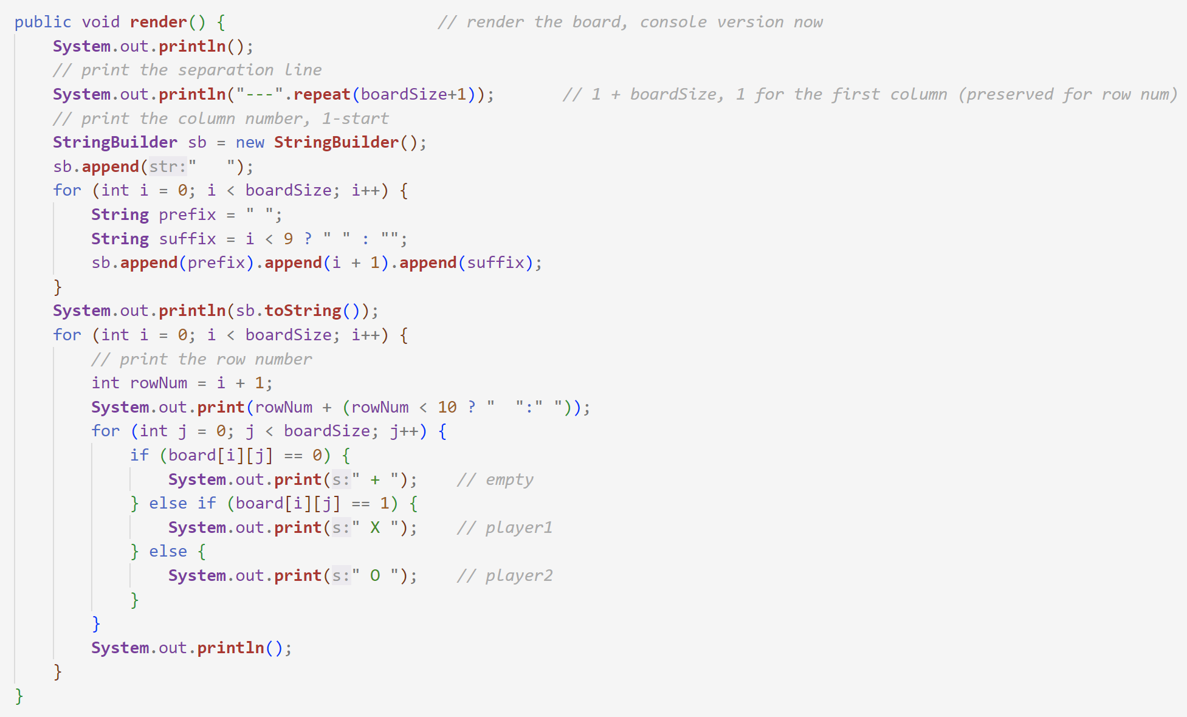
${\text{(}\text{Iteration} \text{1}\text{)}}^{+}:$ Implement & Improve
Better show the row and column number as numerical input is used
Denote “+” for some unused position, “X” for the black stone, and “O” for the white stone
Loop over the rows and columns to print all those required things
Alignment should be considered
render()
(A Quick Review Here)
Note: actually the whole render() function is optional as we’d use JavaFX for rendering in the future, but we need such function for the whole
program to be “complete” so that we can make some tests and ensure that our core components work properly, to avoid messing up with
those future GUI codes.
boardSize
-
-
-
-
-
-
-
-
-
…
-
-
-
-
-
-
-
-
-
…
1
2
…
9
1
0
1
1
…
1
+
+
+
O
+
2
+
X
+
+
+
…
boardSize
9
+
+
X
+
+
1
0
+
+
+
+
+
1
1
+
+
+
+
+
…

Slide 7
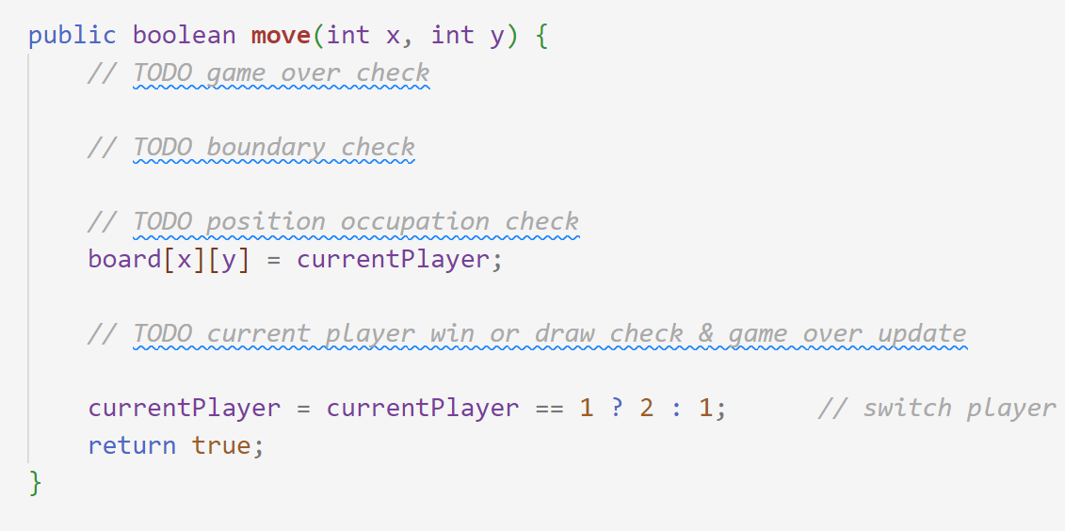
${\text{(}\text{Iteration} \text{1}\text{)}}^{+}:$ Implement & Improve
Maybe the most proper name should be
“placeAStoneAt(x,y)”
Not allow to place if the game is over
Not allow to place if the position is out of boarder
Not allow to place if the position is used
Update the position to be used by current player
Update gameOver and winner if the game is over with checkWin()
For the point above, also consider the draw of a game
Switch the current user
move(x, y)
i.e. the place() function

Slide 8

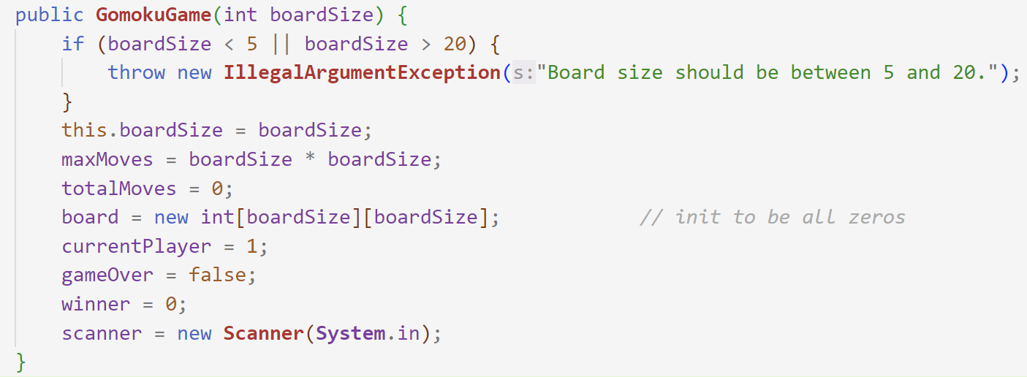
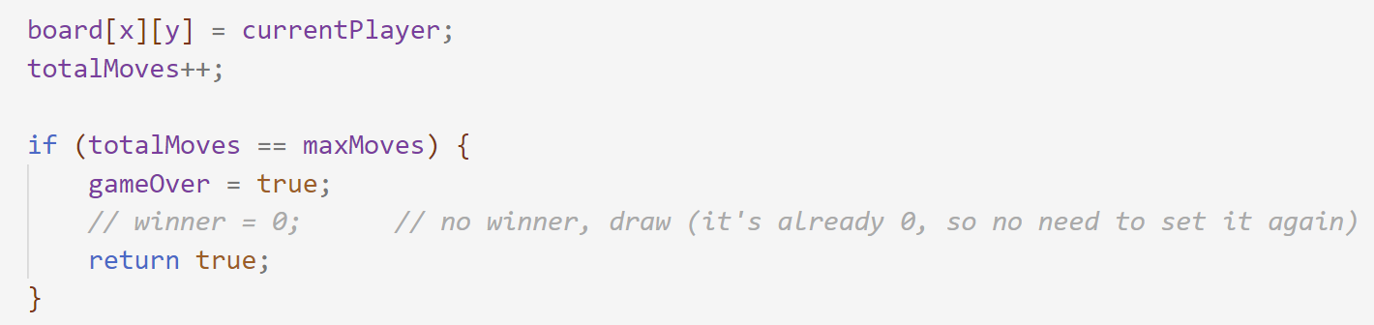
${\text{(}\text{Iteration} \text{1}\text{)}}^{+}:$ Implement & Improve
Recall – How to efficiently check the “draw of the game”: Maintain the total number of moves and check whether it reaches the maximum limits is more efficient than checking the whole board
Add these new fields
Maintain the total number of moves and the maximum allowed number of steps based on board size
Increase the record for total number of moves each time there is some feasible move
Set the game to be over if there isn’t any winning condition encountered and the total number of moves reaches the limit
Init these new fields
Update total moves
Use it for checking

Slide 9
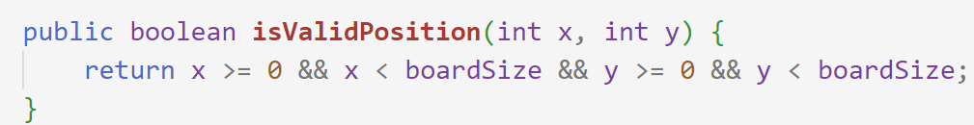
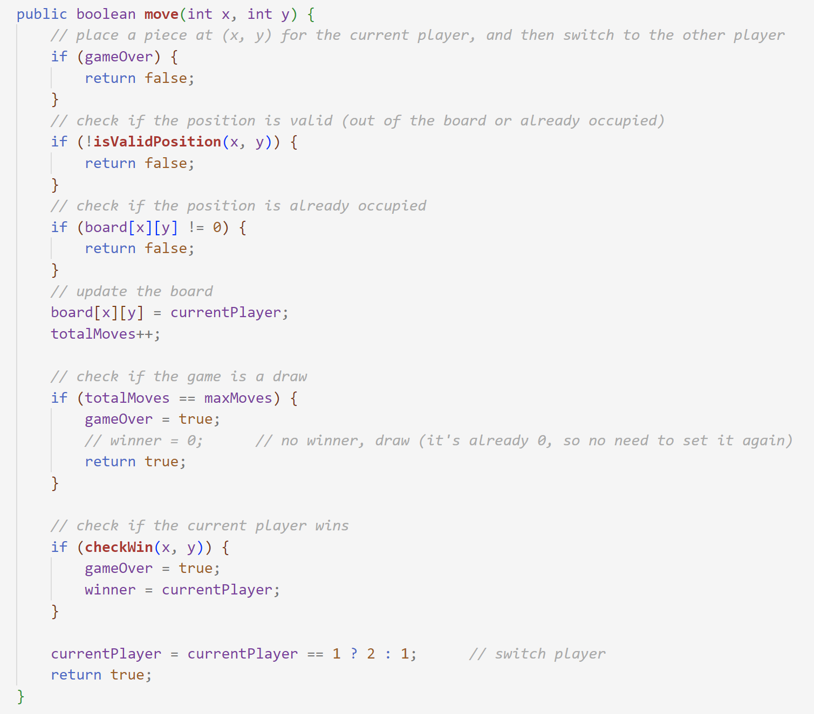
${\text{(}\text{Iteration} \text{1}\text{)}}^{+}:$ Implement & Improve
move(x, y)
Or say “isOutOfBoundary(int x, int y)”
i.e. the place() function
Not allow to place if the game is over
Not allow to place if the position is out of boarder
Not allow to place if the position is used
Update the position to be used by current player
Update gameOver and winner if the game is a draw,
or is over with checkWin()
Switch the current user

Slide 10
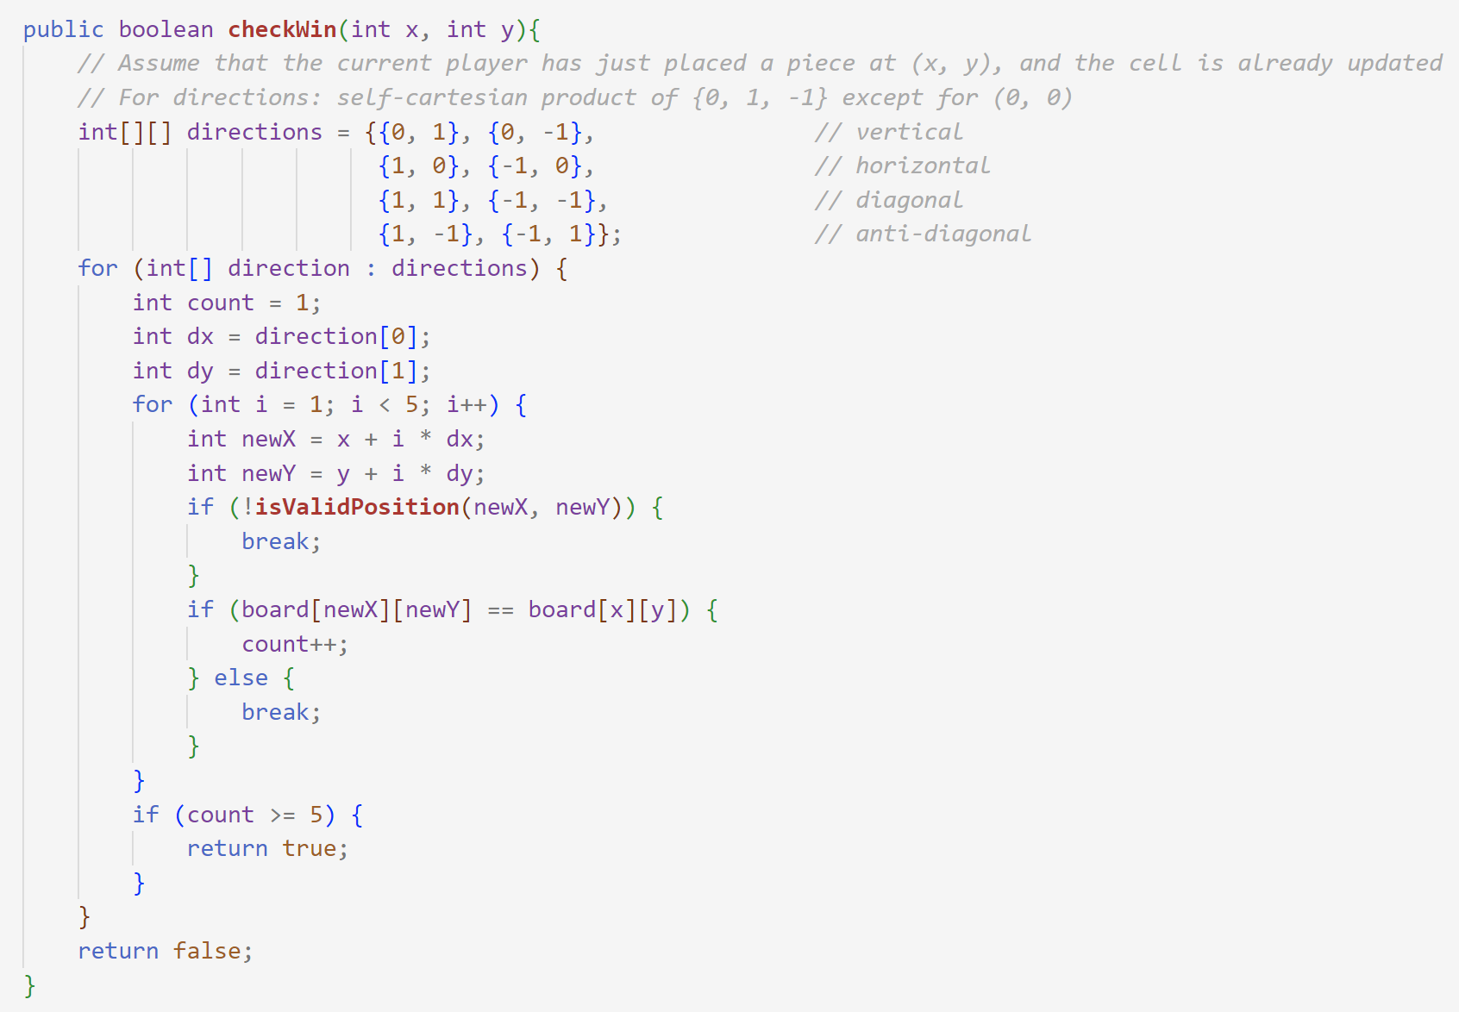
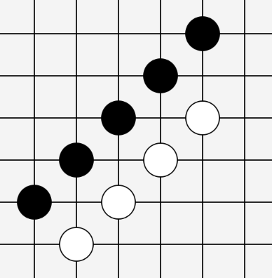
${\text{(}\text{Iteration} \text{1}\text{)}}^{+}:$ Implement & Improve
Recall - How to efficiently check whether some player wins: Do not check each state, or say the whole board, as it would be complex to traverse the board and check whether there exists some five-stones-in-one-line; instead, as long as each time when some stone is placed, the 8 directions starting from such stone is checked, there wouldn’t be any winning condition missed, and the computational cost each time is low [Error: this is some incomplete implementation].
checkWin()
(The key function
not yet done)
{0, 1, -1} × {0, 1, -1} / (0,0)
8 directions in all

Slide 11
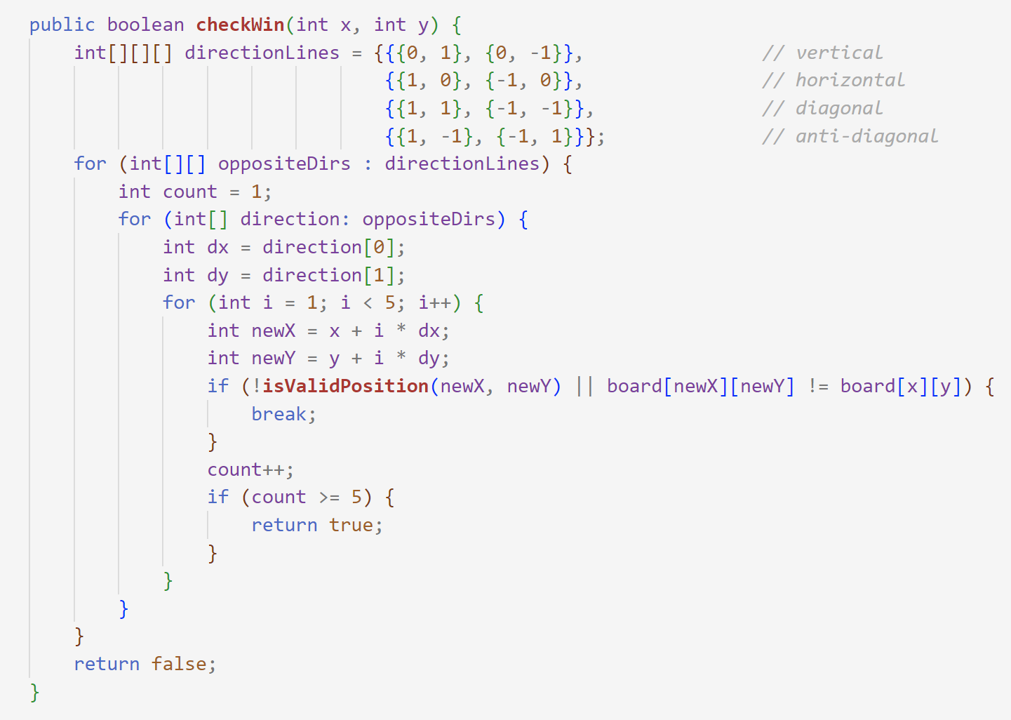
${\text{(}\text{Iteration} \text{1}\text{)}}^{+}:$ Implement & Improve
Recall – Fix version: the former algorithm could miss some case that “some 5-stones-in-one-line just lack some stone somewhere in-between of a line while such place is filled later“. We may check the four direction-line instead, with each line including two directions. As long as some placement stretching on some line (in two opposite directions) reaches 5-stones-in-one-line, we can tell that someone wills.
checkWin()
(The key function
not yet done)
4 direction-lines (positive direction & negative direction)

Slide 12
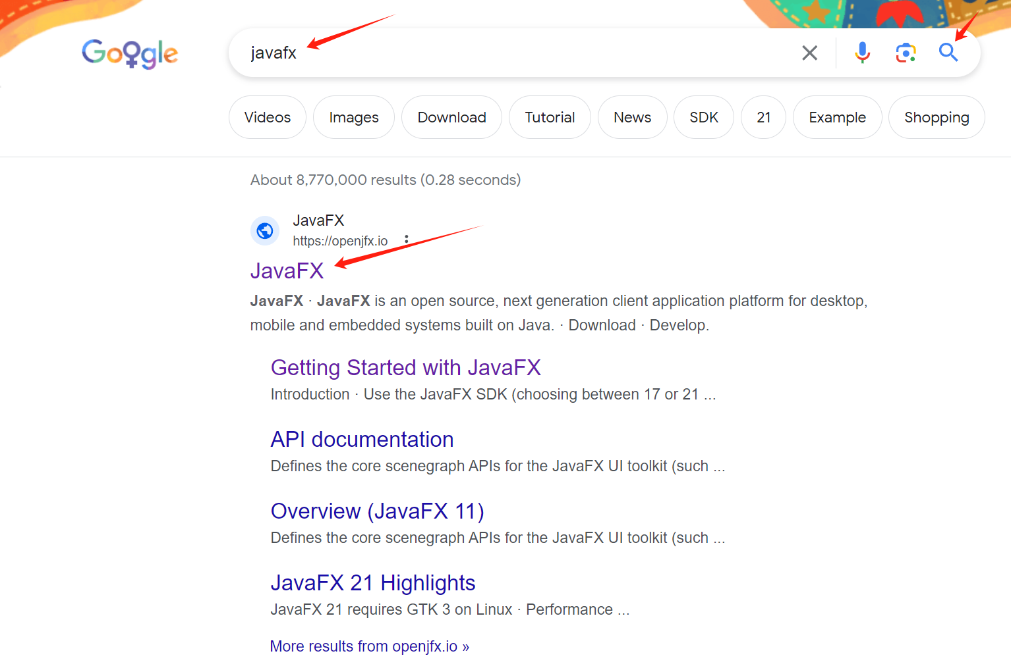
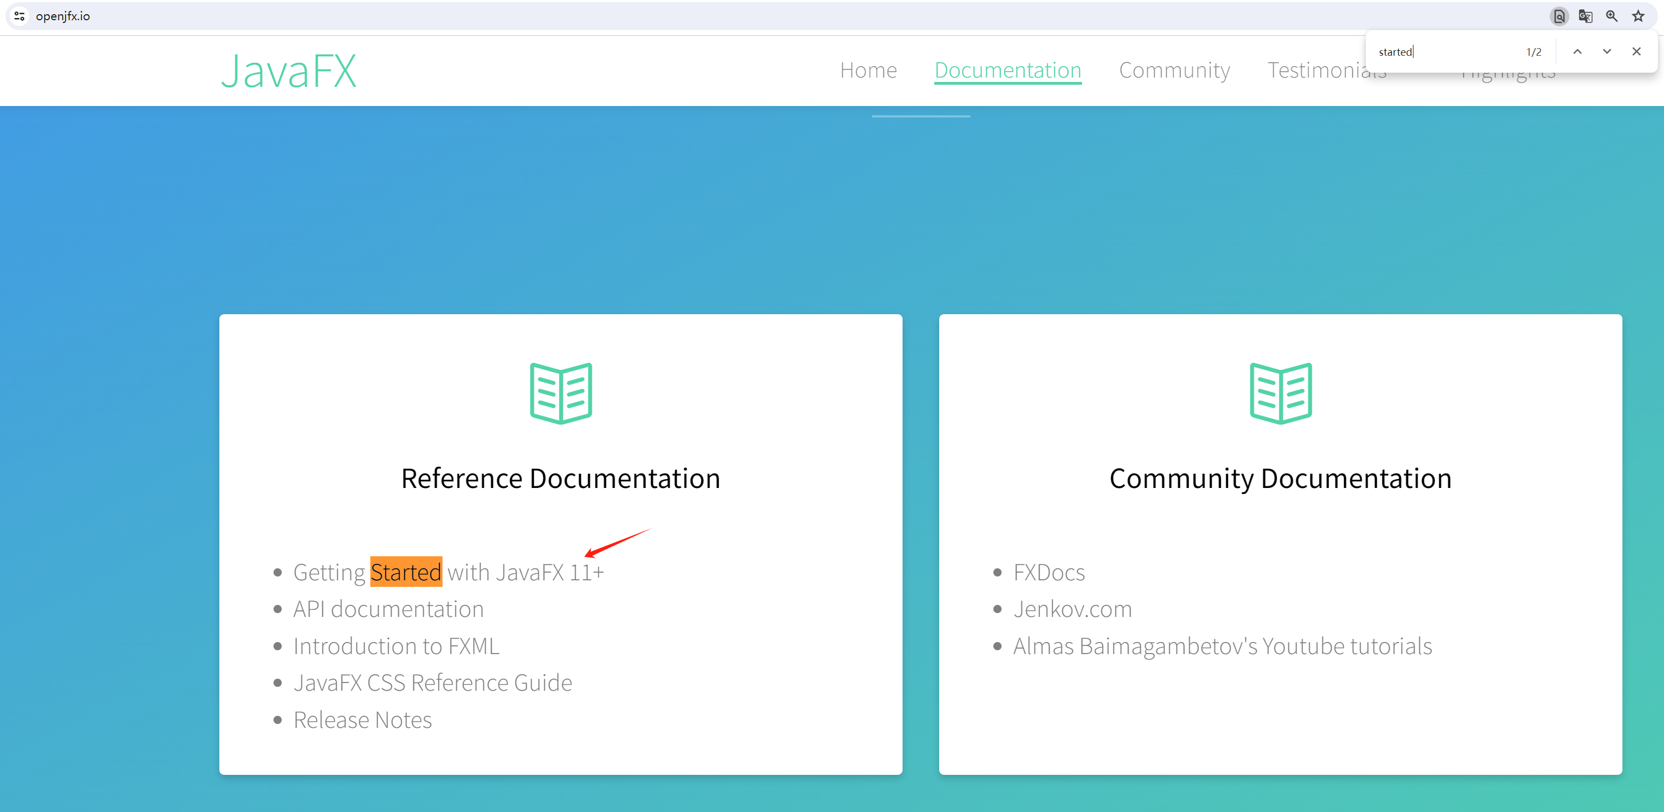
Preparation for JavaFX Application
Believe yourself that you can search the results you want with:
Correct search engine (e.g. Google for English centents)
Correct keywords (e.g. add “official website” for authority
A good network for the world wide web (not taught in the lecture or the tutorials; ask your classmates for good examples)
Shortcut entrance via the search Engine
ctrl + F(Win/Linux)
⌘ + F (macOS)
On the official website, search:
“Get/Getting started” for beginners
“Introduction/Introduce” etc. is also fine
“Document” for API usages in details
… and have a quick glance over the website

Slide 13
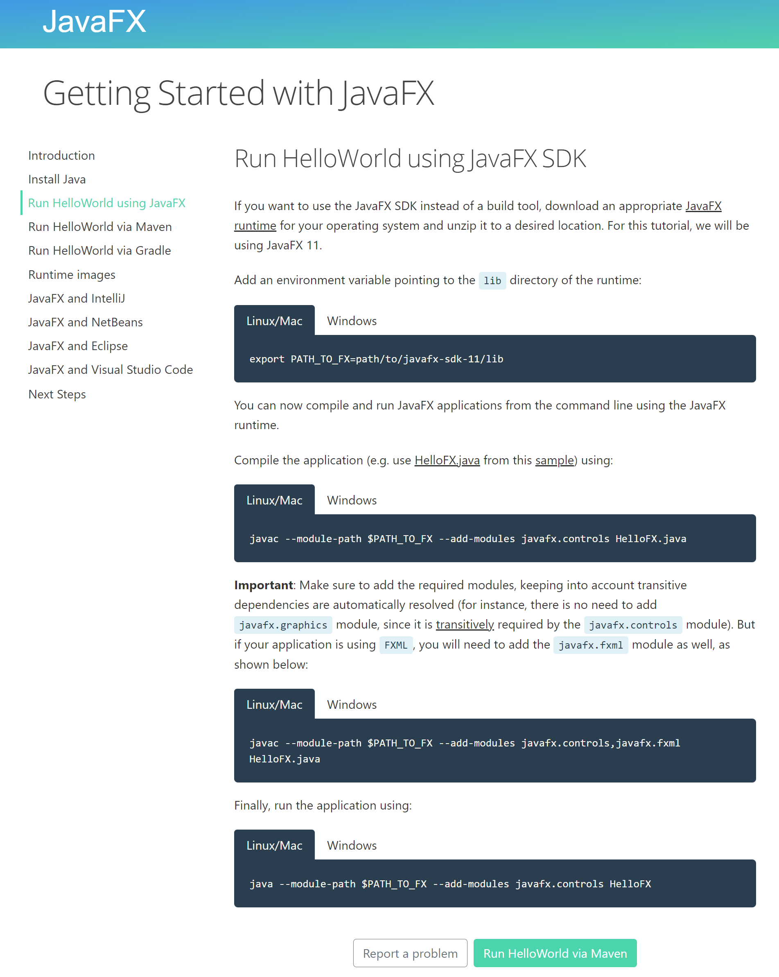
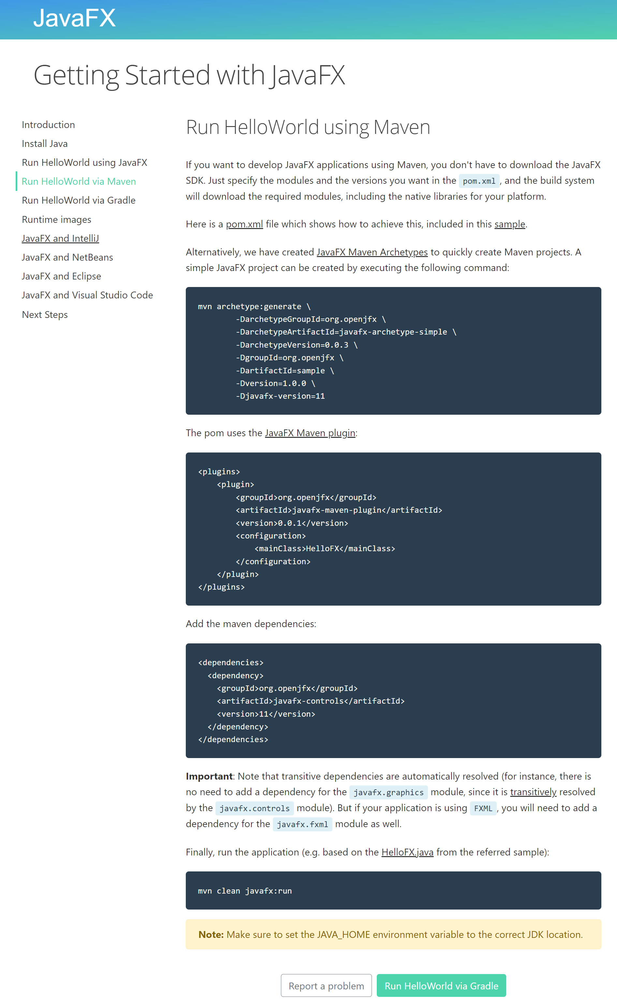
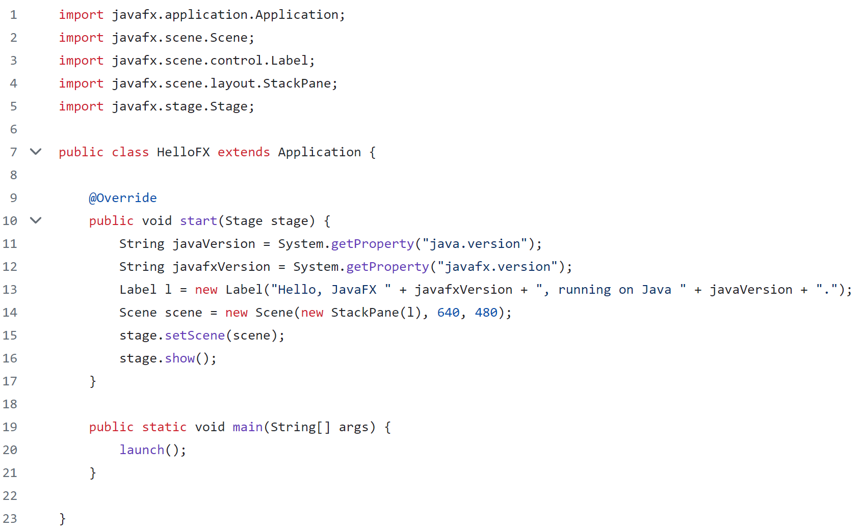
Preparation for JavaFX Application
Provides ways of creating JavaFX projects with/without maven
Doesn’t relies on IDE
Good to know why it works
Simplest code without requiring the FXML file

Slide 14
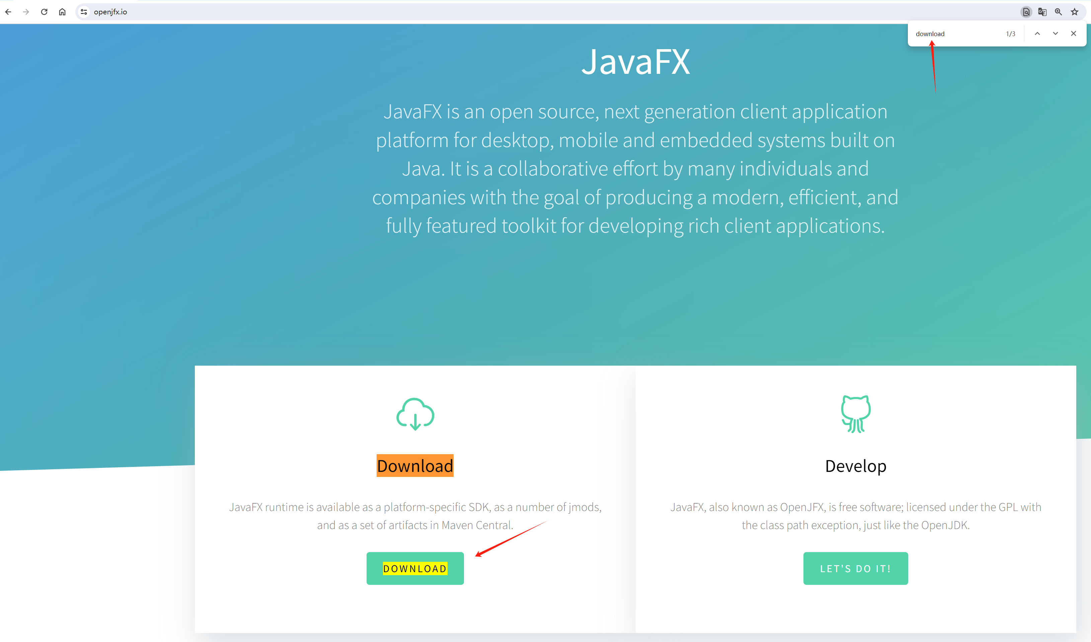
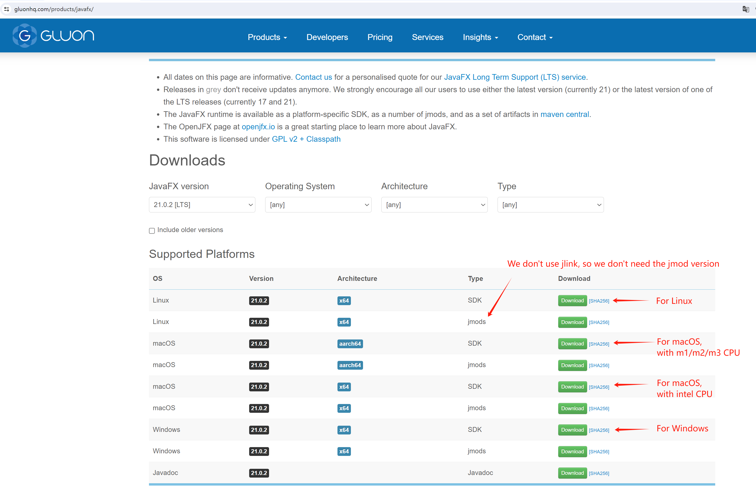
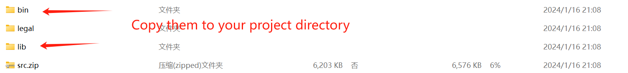
Manually Configure JavaFX SDK
Search “Download” for quick location (sometimes you can try “Installation”)
The software distribution can be:
Either portable or installable
For different systems like Windows/Linux/macOS/Android
For different CPU architecture like x86-32, x86-64 (or AMD64, x64), aarch64 (apple’s architecture), arm64 (common for android devices)
The binary files directory (e.g. “bin”) are usually for those executable parts
ctrl + F(Win/Linux)
⌘ + F (macOS)
In the next step, let’s add the VM options/arguments.

Slide 15
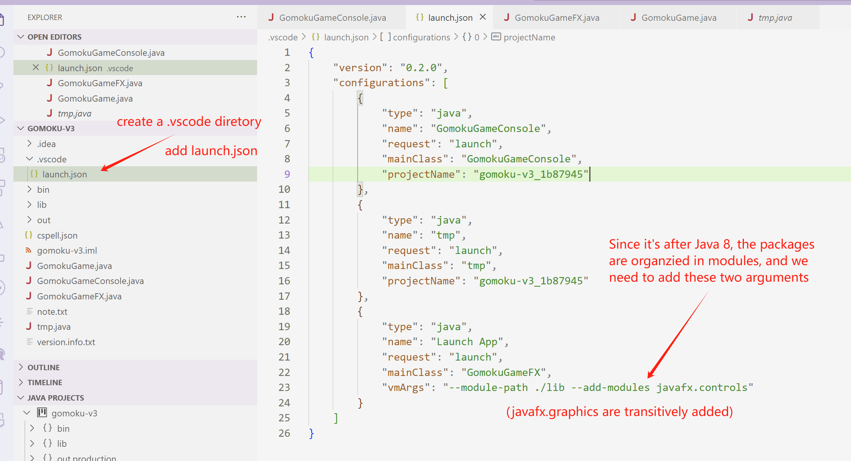
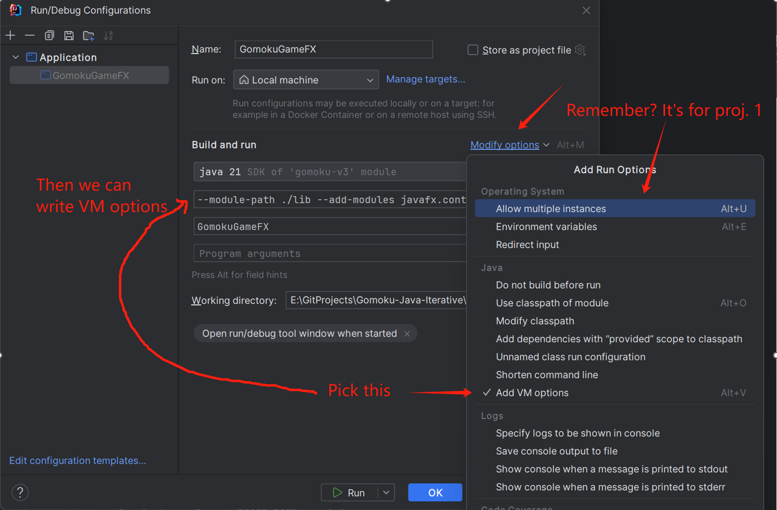
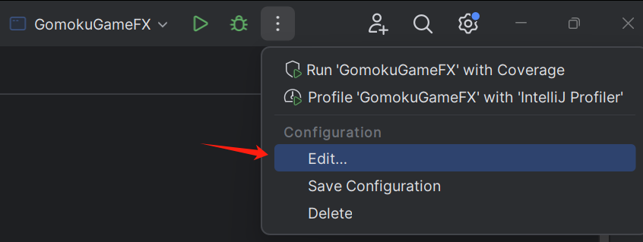
Manually Configure JavaFX SDK
Note that now it’s ready for us to execute some JavaFX program.
(the modules added depended on your code, e.g. you might need
to add `javafx.fxml` if you are using some FXML file).

Slide 16
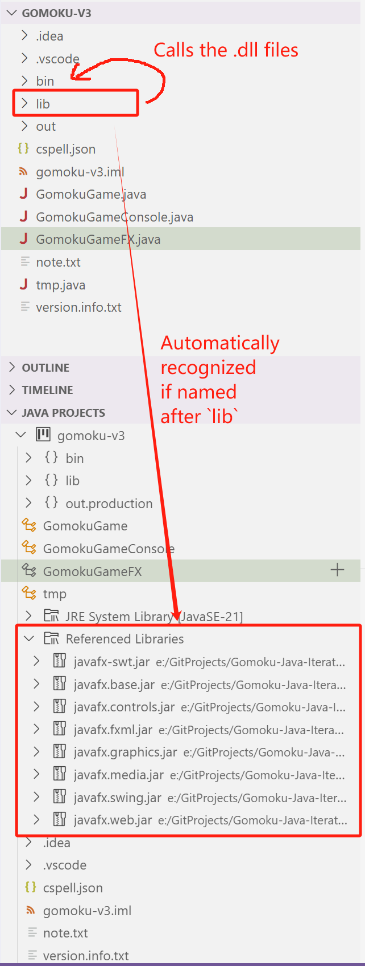
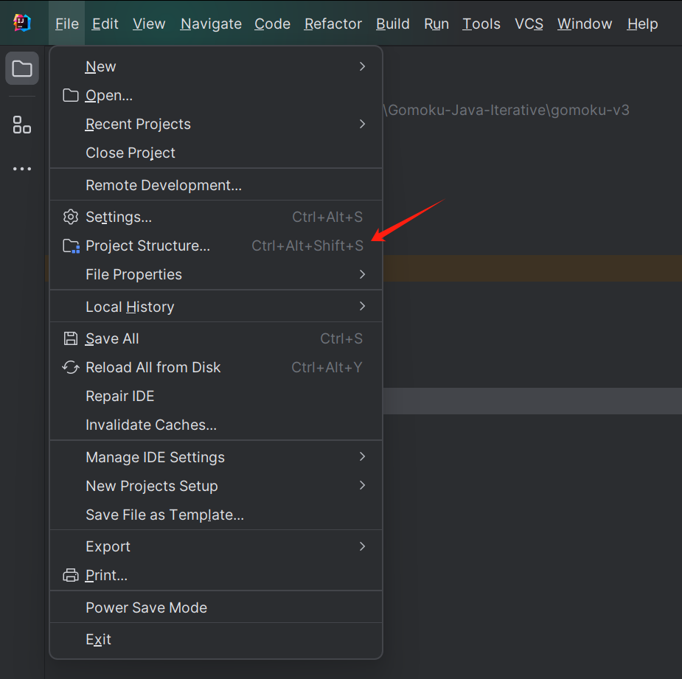
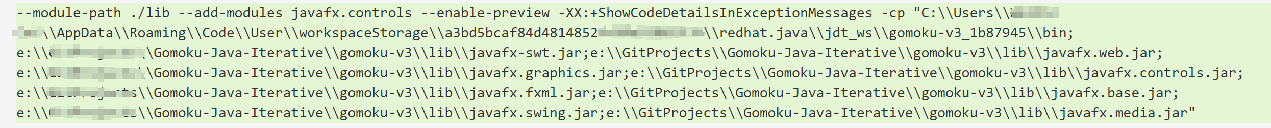
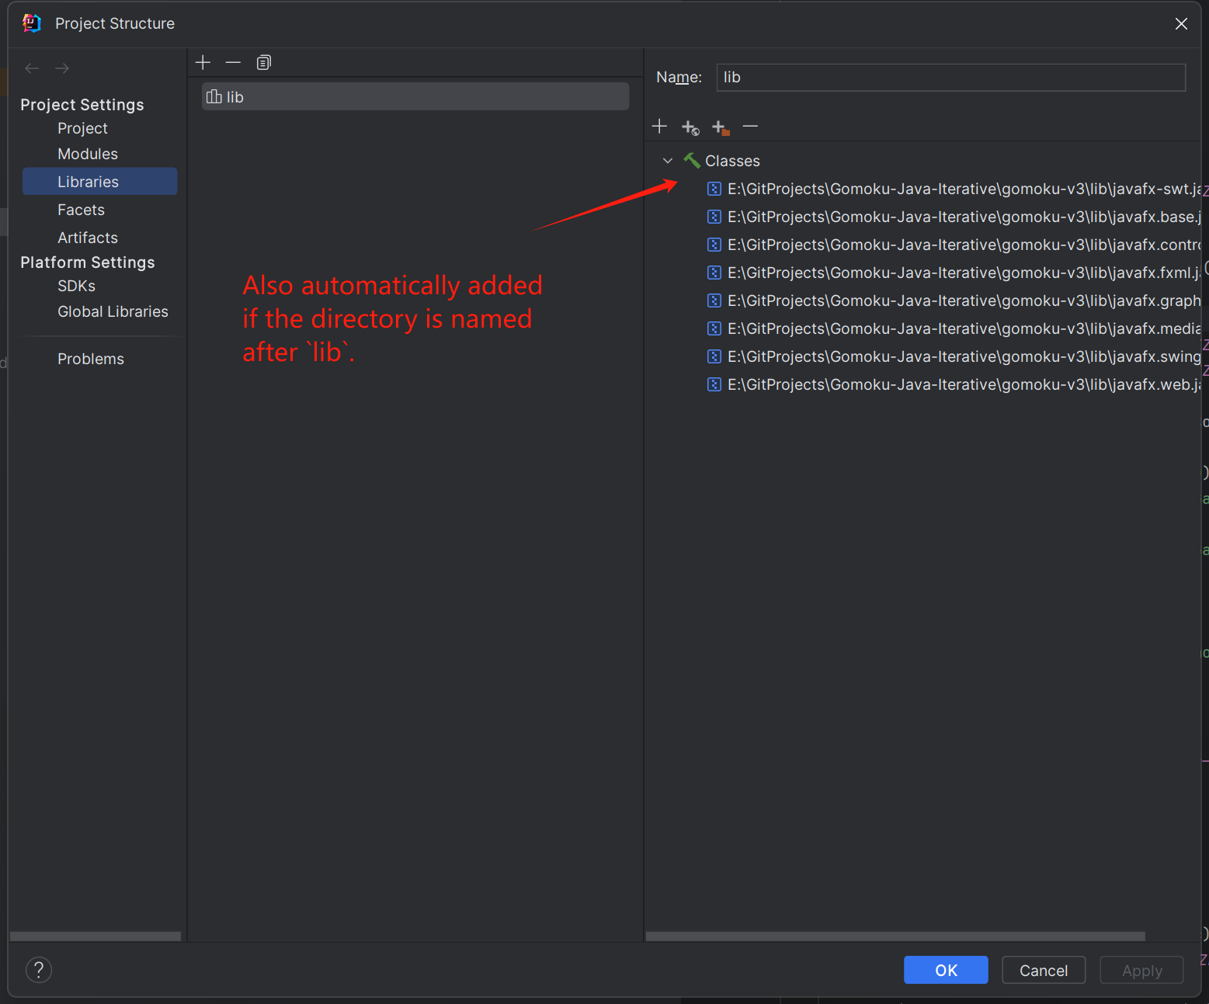
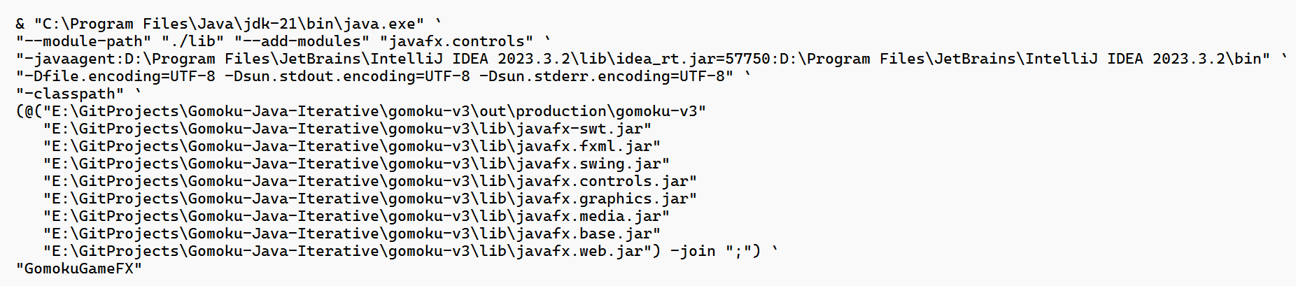
Why it works?
VM args just added
-cp i.e. -classpath, telling the path of the compiled .class files
Compiled files of your project
The libraries you just added (which are already compiled, stored inside the jar file)
It’s quite similar for IDEA. Actually the translated command is executed,
and it’s just not some magic (not that only the button works)
Note 2: the build command is actually executed!
Note 2: it’s just for explanation! You need to do NOTHING!

Slide 17
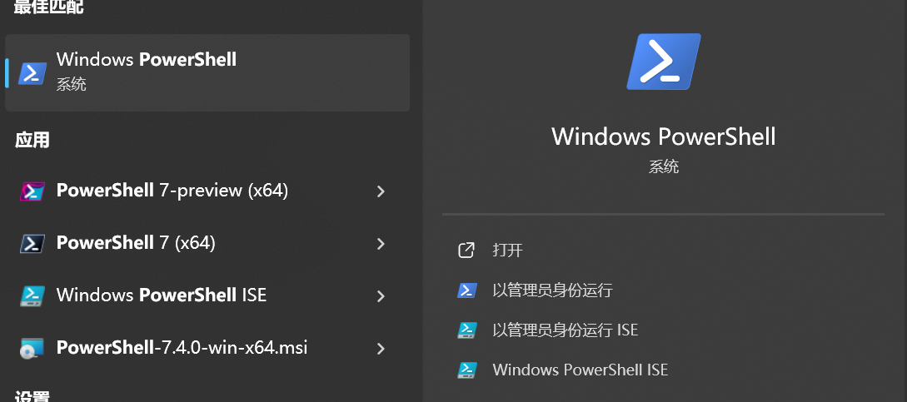
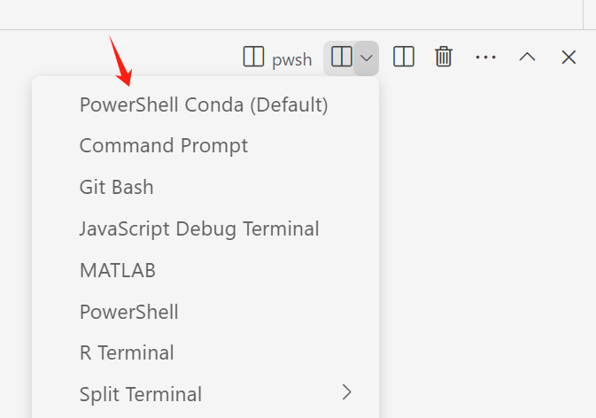
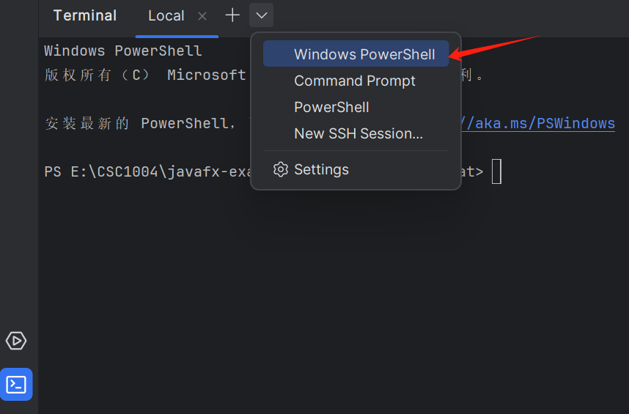
Use Maven for JavaFX Project
Locate (using “cd” command) at some directory that you want to create some JavaFX project at (do not create the project directory ahead of time), and then type:
For Linux/macOS (i.e. UNIX-like systems)’s shell
(e.g. sh, bash, zsh)
For Windows Powershell (not CMD)
mvn archetype:generate \
-DarchetypeGroupId=org.openjfx \
-DarchetypeArtifactId=javafx-archetype-simple \
-DarchetypeVersion=0.0.3 \ -DgroupId=org.openjfx \
-DartifactId=sample \
-Dversion=1.0.0 \
-Djavafx-version=11 \
-DinteractiveMode=false
mvn archetype:generate `
"-DarchetypeGroupId=org.openjfx" `
"-DarchetypeArtifactId=javafx-archetype-simple" `
"-DarchetypeVersion=0.0.3" `
"-DgroupId=com.example" `
"-DartifactId=gomoku-basic" `
"-Dversion=1.0.0" `
"-Djavafx-version=21.0.2" `
"-DinteractiveMode=false"

Slide 18
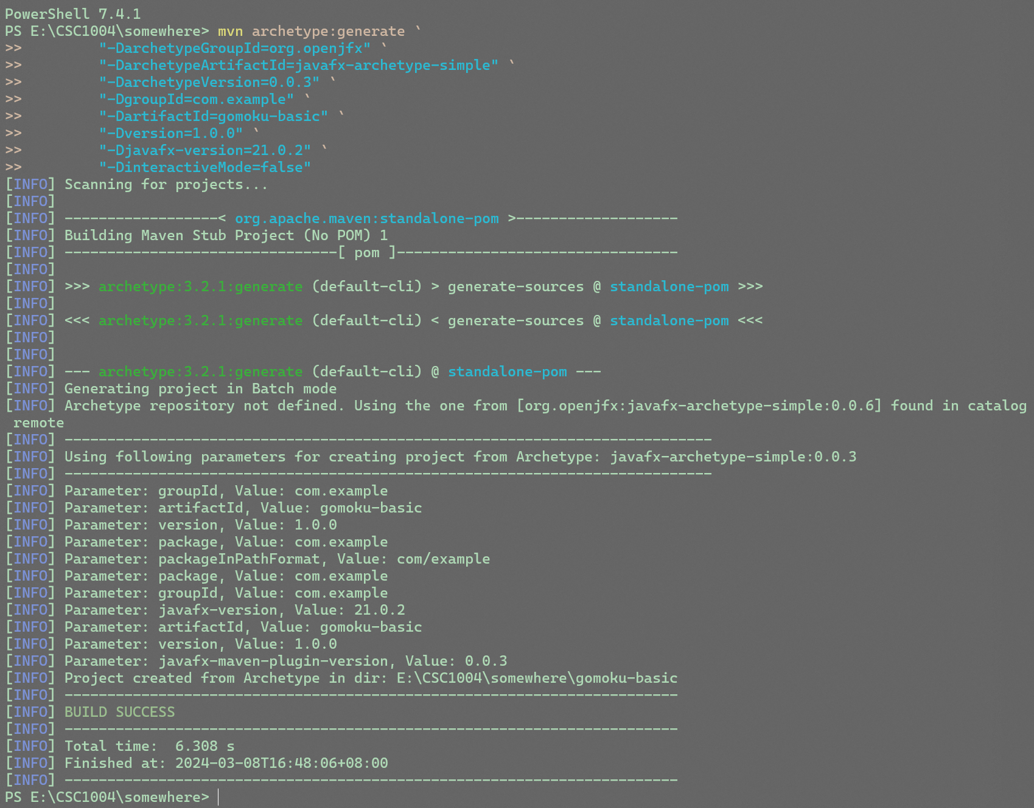
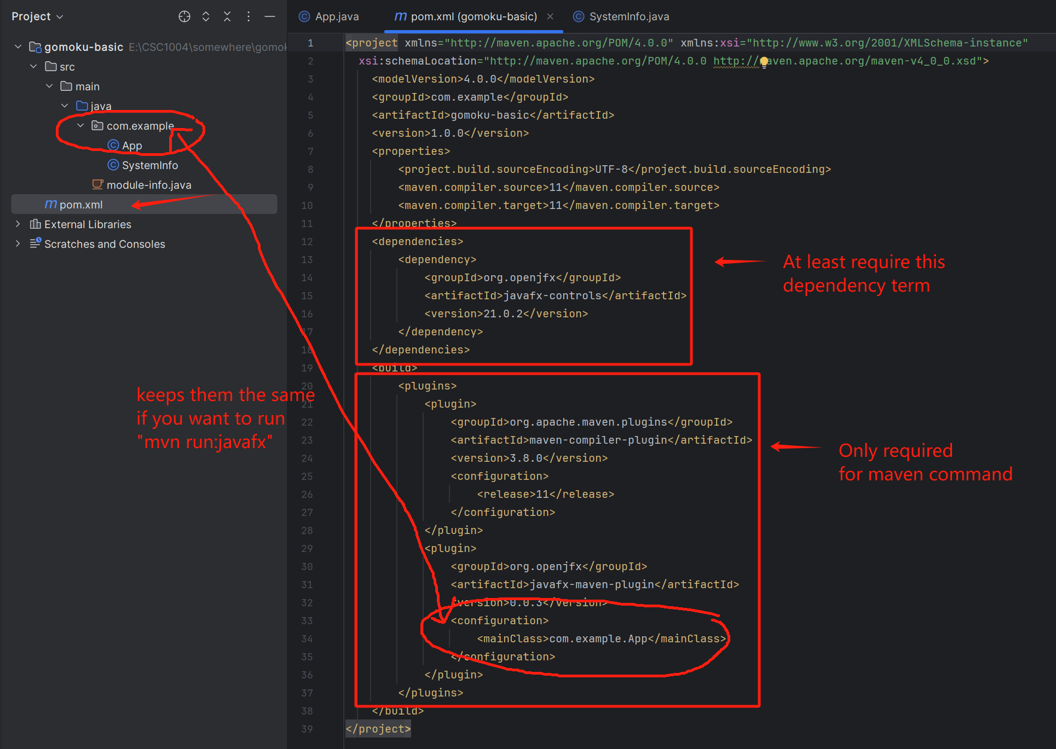
Use Maven for JavaFX Project

Slide 19
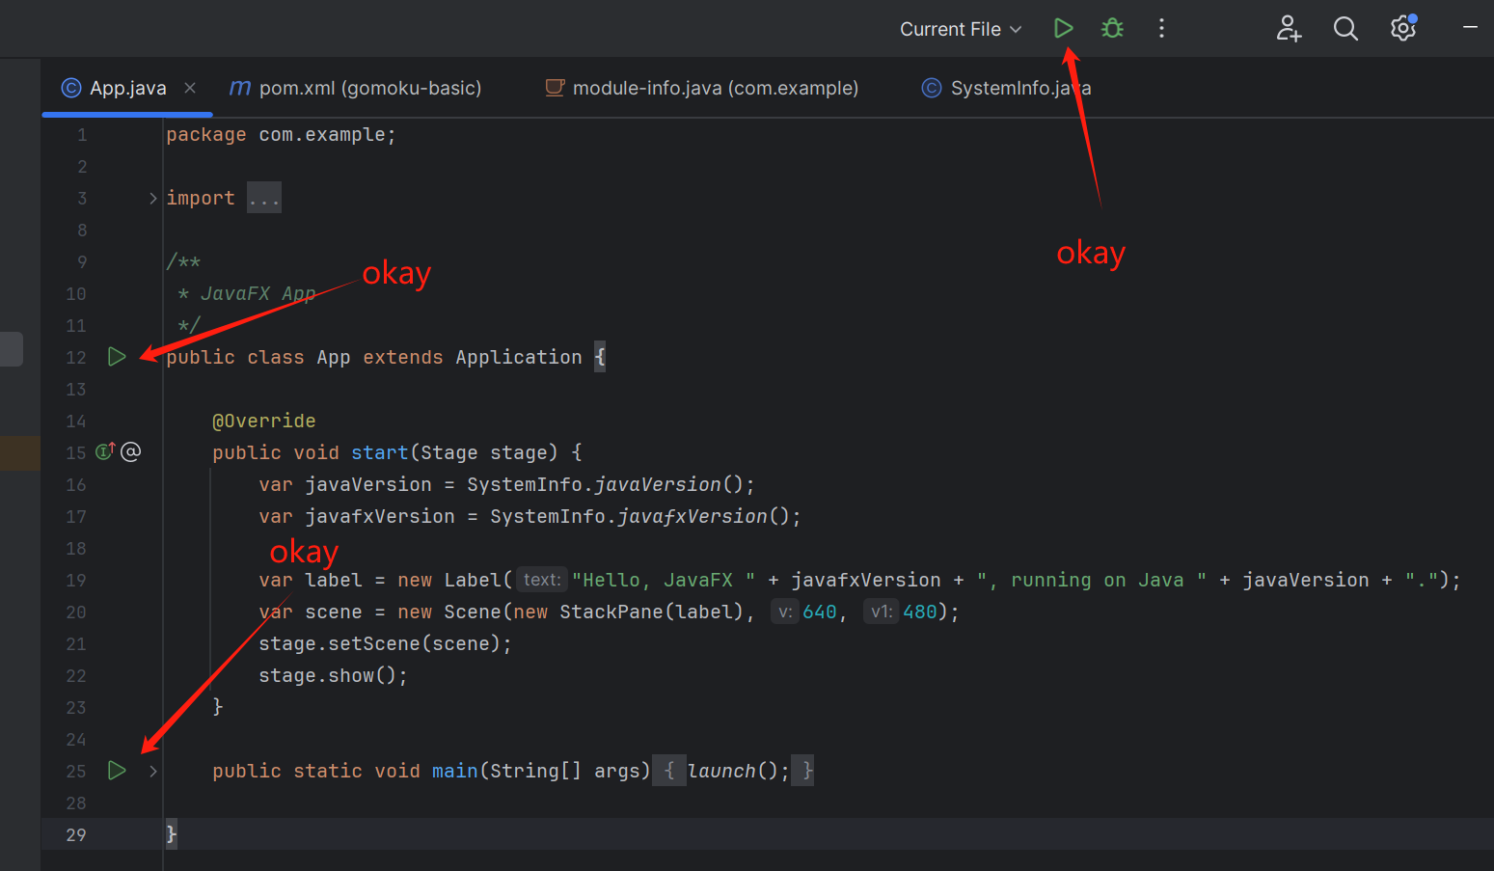
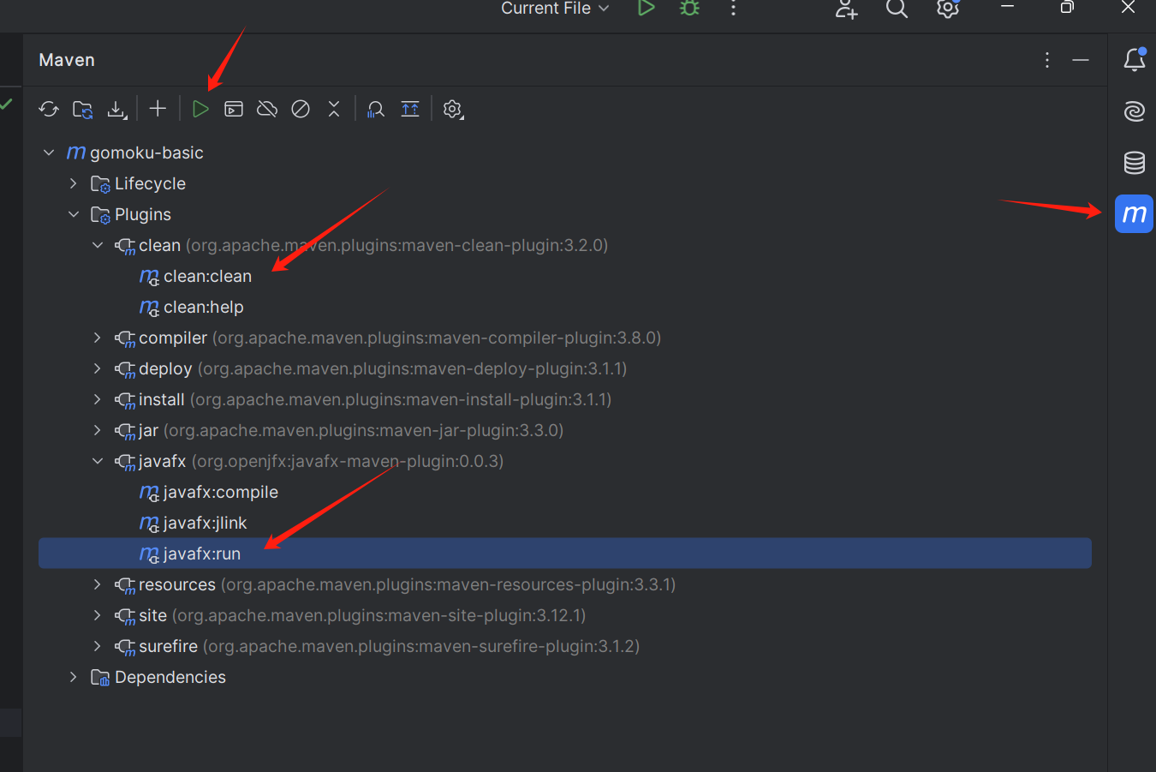
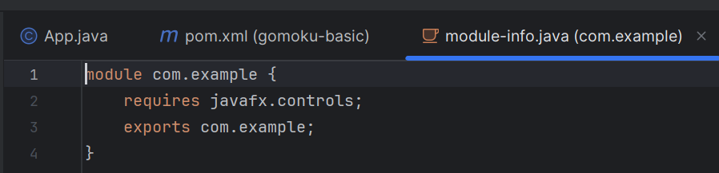
Use Maven for JavaFX Project
But it’s hard to configure `module-info.java` …
Better use the maven command.
You can either use the integrated maven of the IDE;
Or just use command line: `mvn clean javafx:run`
(But you need to have your maven installed)
We haven’t use Reflex (e.g. FXML)!!! It’d be harder.

Slide 20
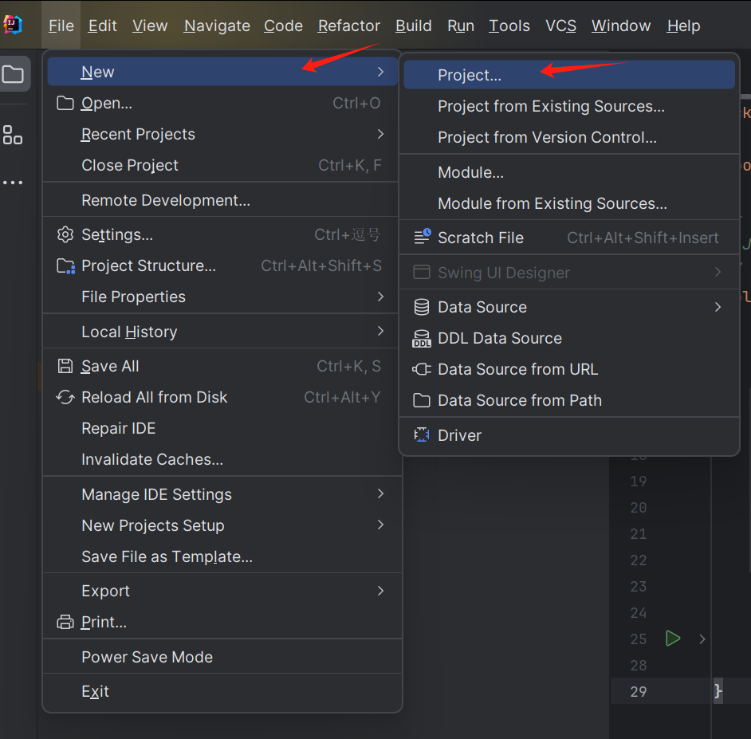
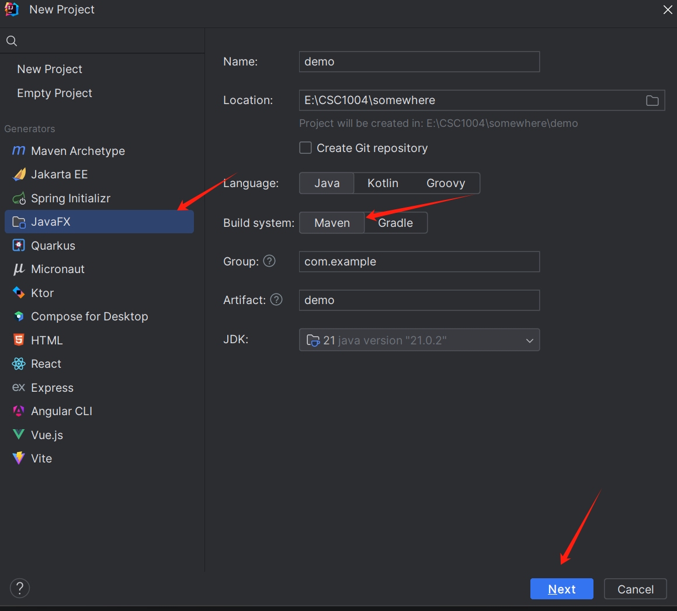
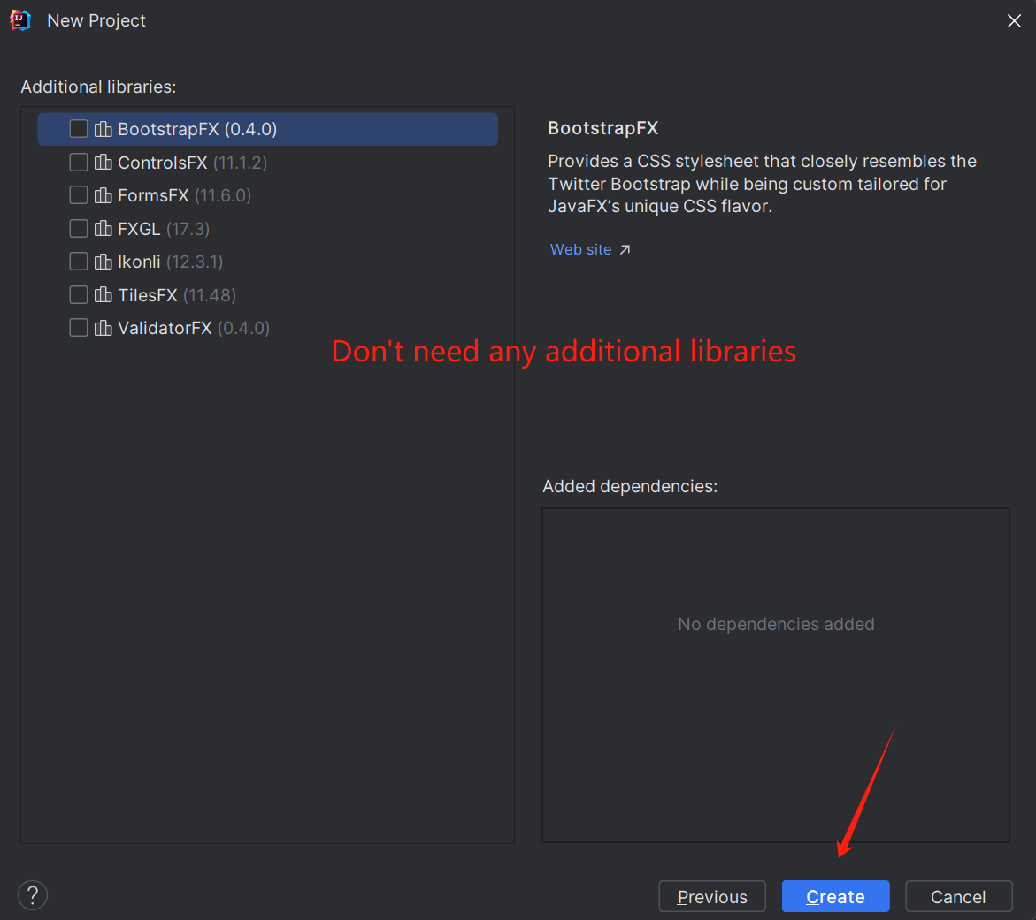
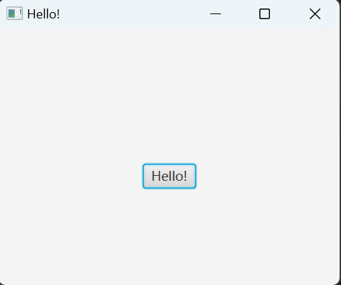
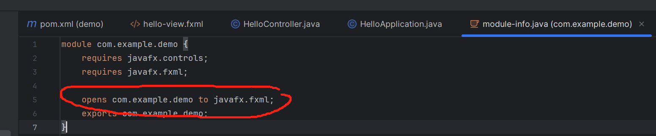

Use Maven for JavaFX Project
You need to know what to open
Hard to know for complex project
You may remove the `module-info.java` and modify the `pom.xml` for the configuration part of the javafx plugin
Remove `com.example.demo/` as it’s no longer some module
Use `mvn run:javafx` and you can see that it still works

Slide 21

THANK YOU
林天麟 教授
香港中文大学（深圳）
机器人与人工智能实验室
WeChat: tinlunlam

